Slide 1


1/25
MAP-ID
MAP-ID BENGALURU
STOP-CALL-WAIT
15.12.2014
MUSASHI AUTO PARTS INDIA PVT. LTD.
Musashi Auto Parts India PVT.,LTD（BLR） 15/DEC/2014
Power to Value

Slide 2
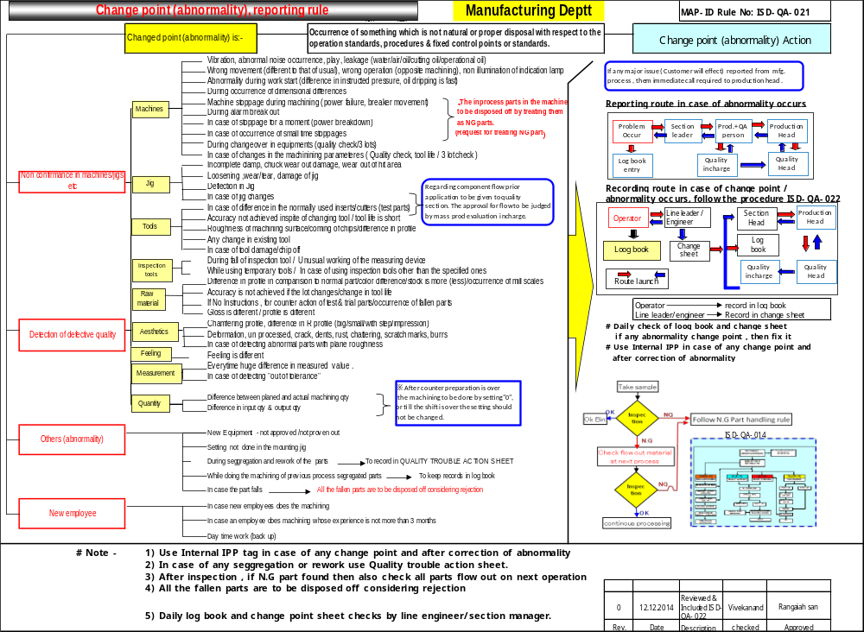

Slide 3
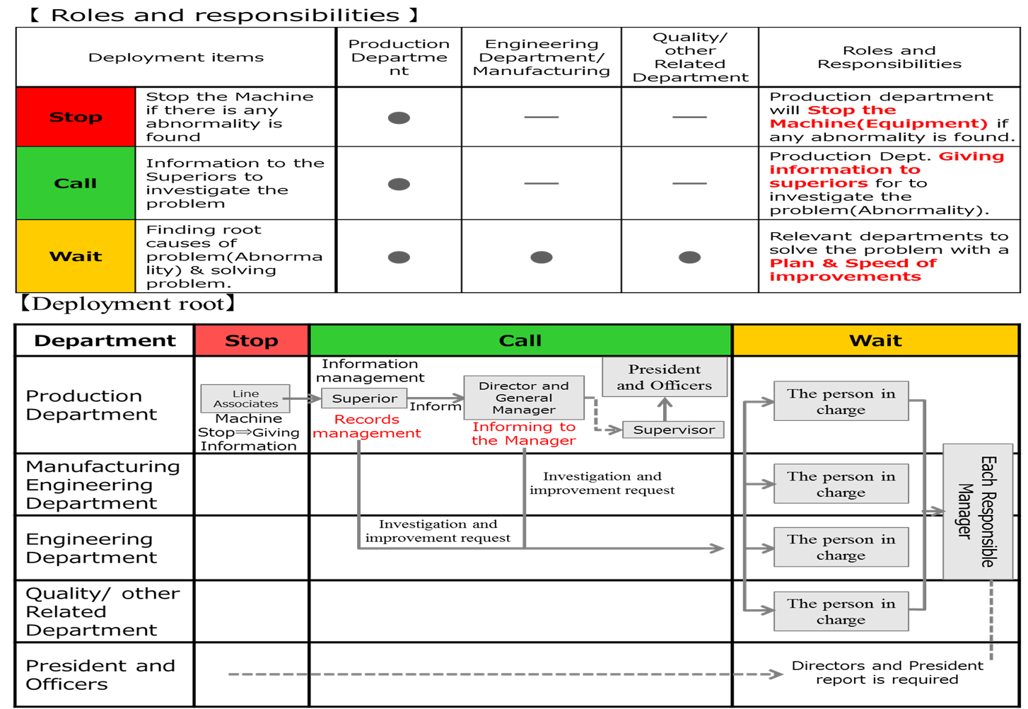

Slide 4
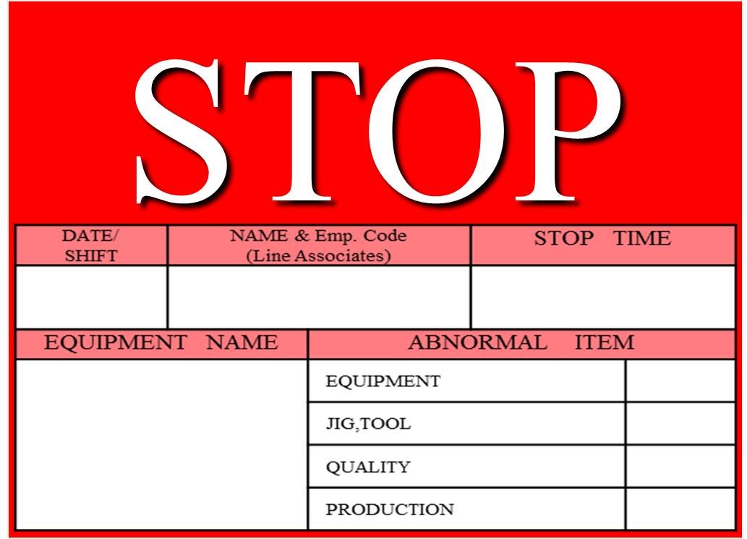
STOP BOARD

Slide 5


Slide 6
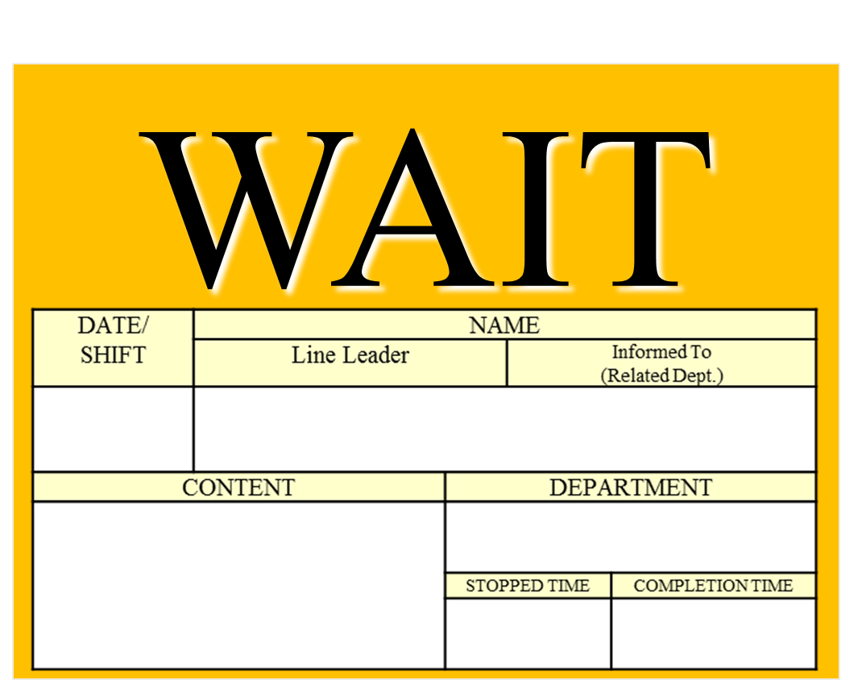

Slide 7
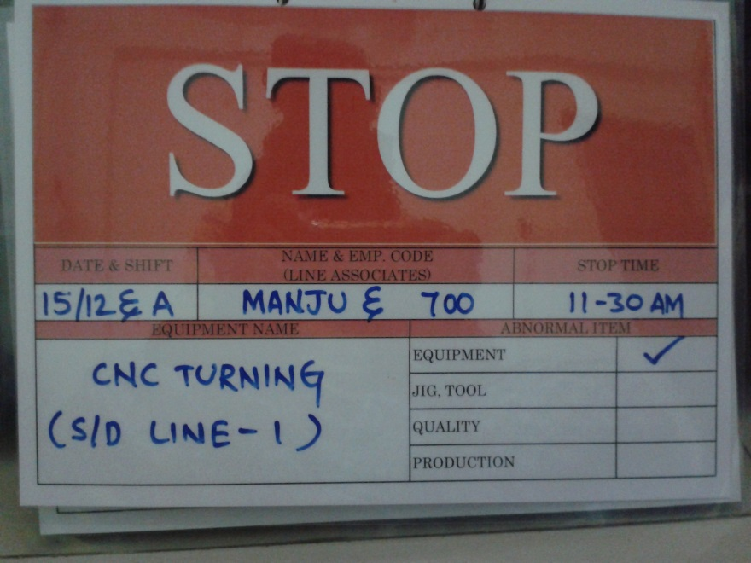
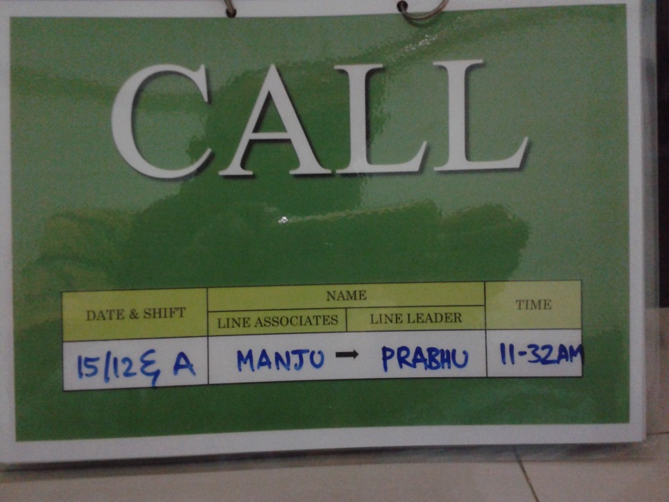
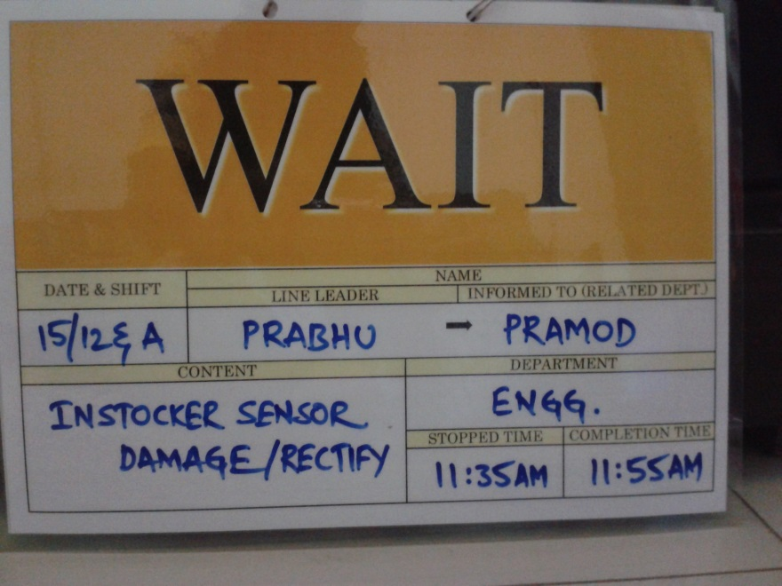
STOP – CALL - WAIT

Slide 8
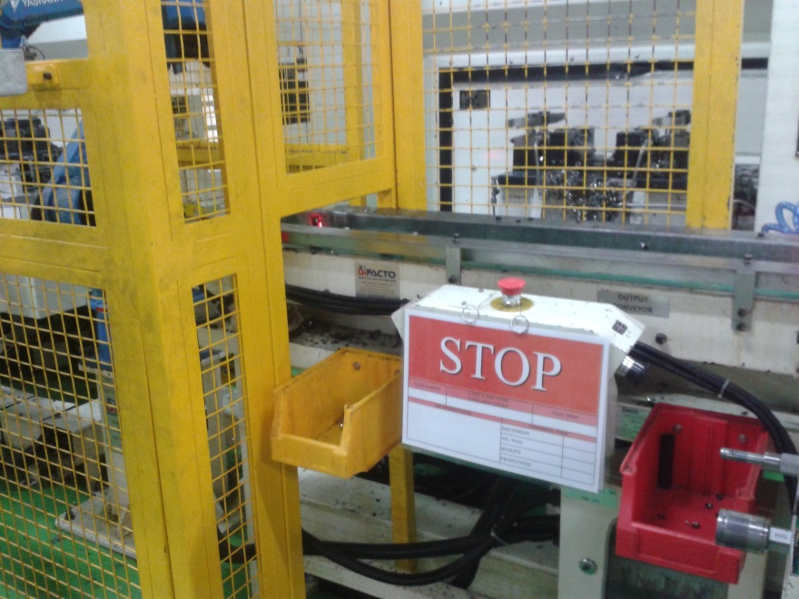
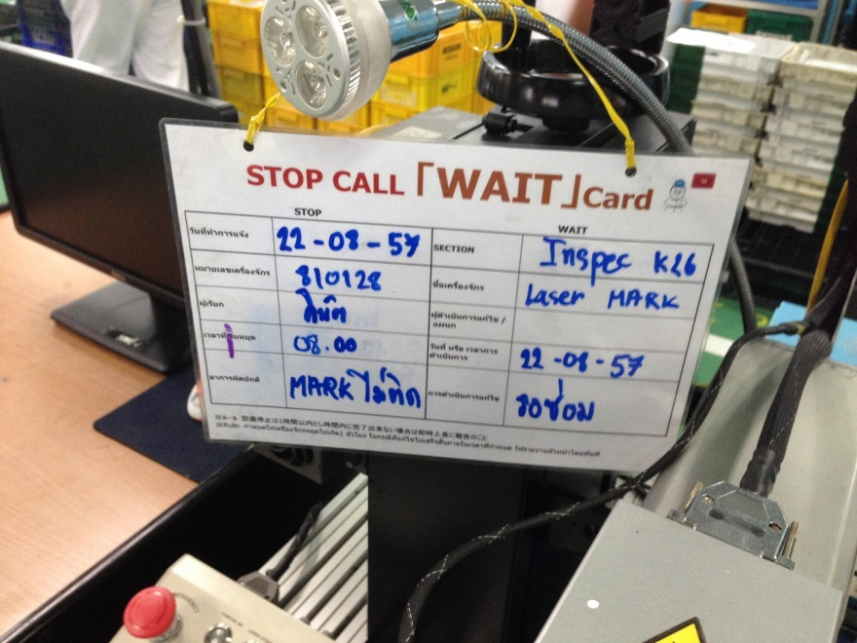

Slide 9
25/25
THANK YOU

